Slide 1
Data Analytics With Tableau
Assignment-1
Name : Katta Ramya
Registered No:20NN1A1291
College Name:-Vignans Nirula Institute of technology and science for women

Slide 2
Task:- Upload the dataset to Tableau, delete the unnecessary columns Create below Visualization:
Bar Chart
Pie Chart
Stacked Bar Chart
Line Chart
Bubble Chart

Slide 3
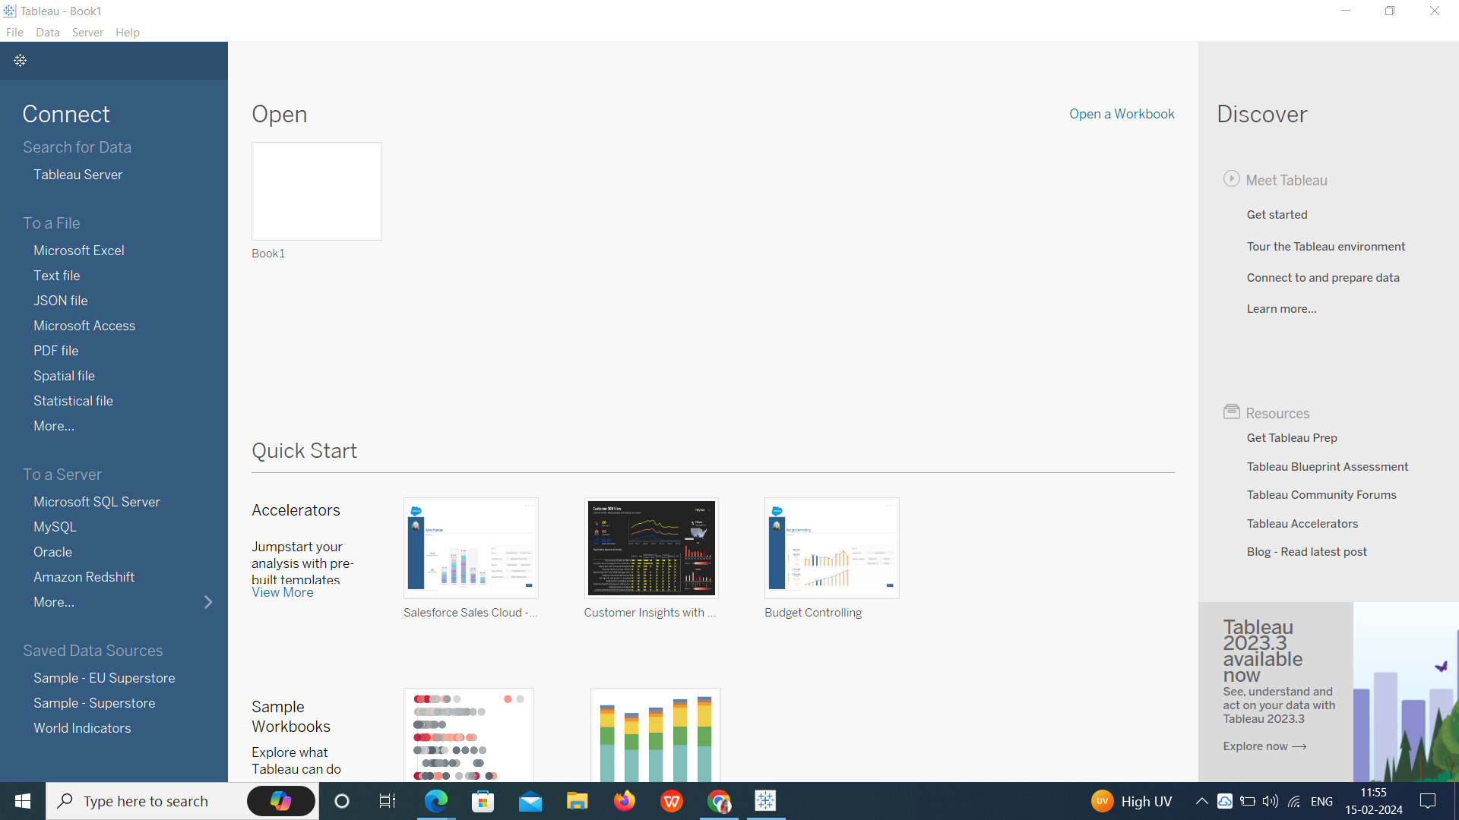
Tableau Starting:-

Slide 4
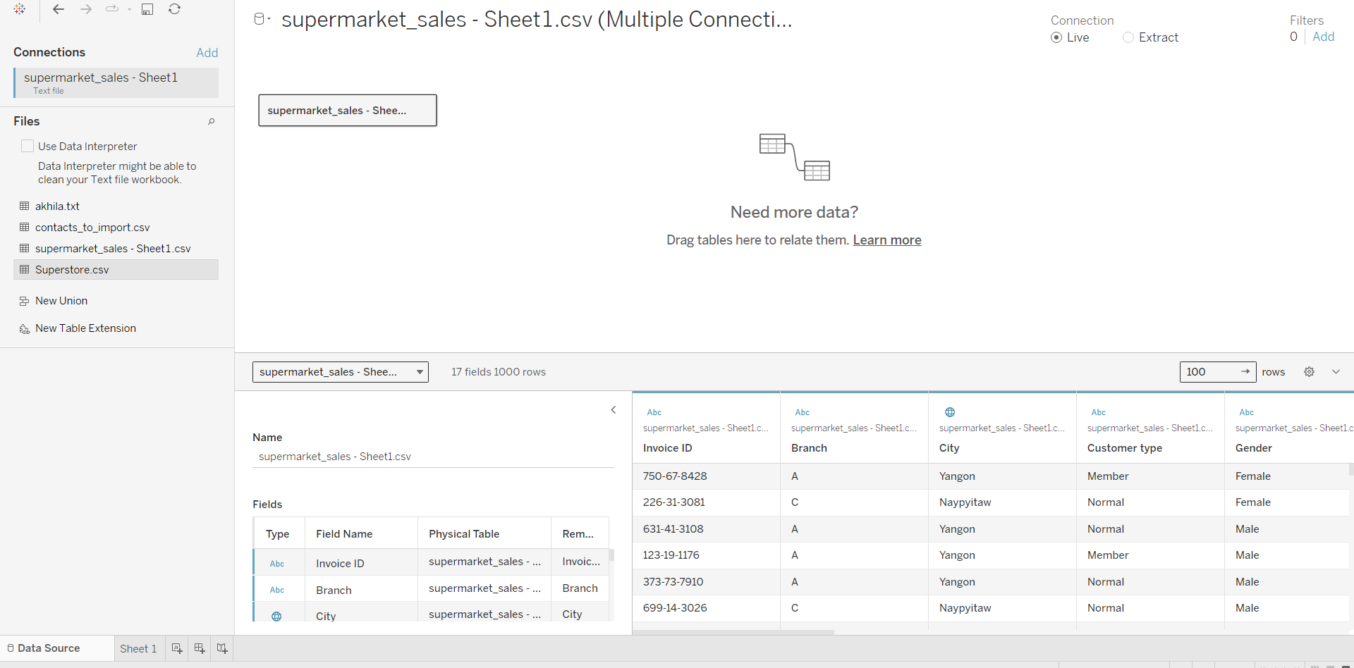
Upload the dataset to Tableau, delete the unnecessary columns:-

Slide 5
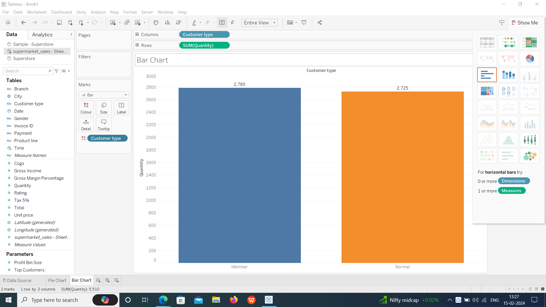
Create below Visualization: Bar Chart:-

Slide 6
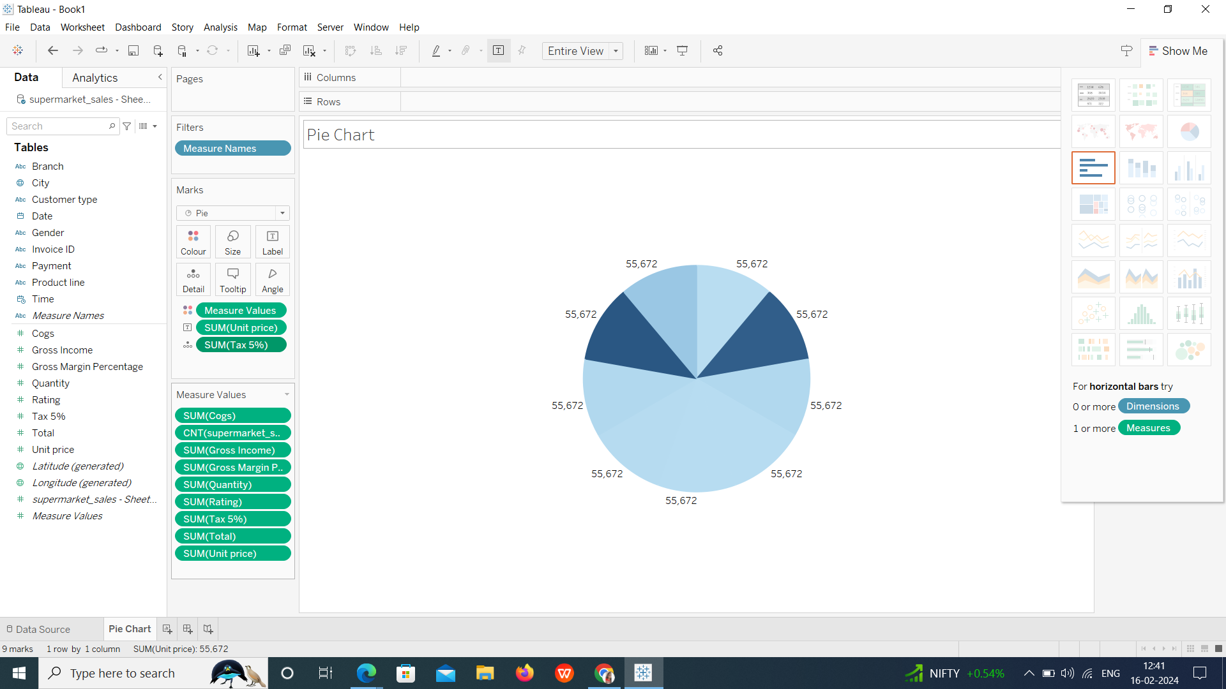
Pie Chart:-

Slide 7
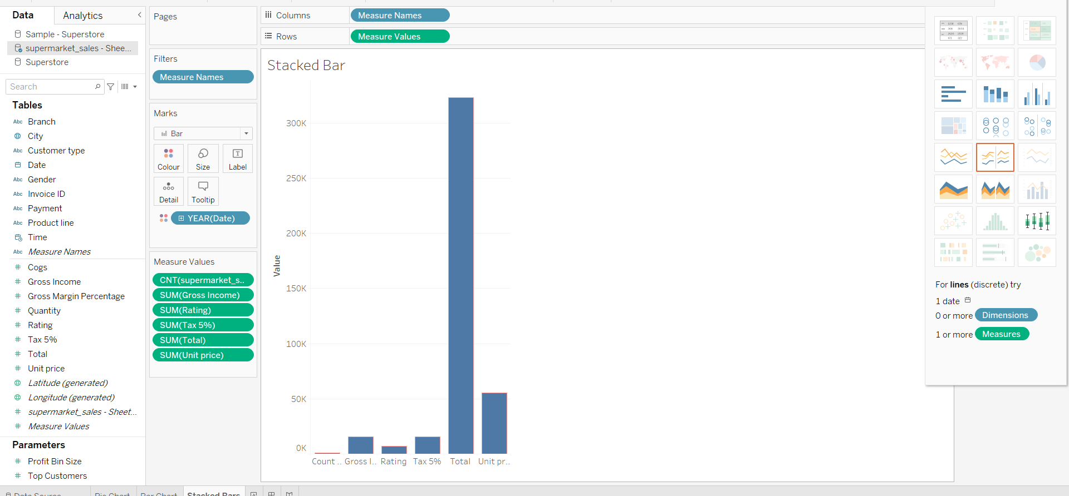
Stacked Bar Chart:-

Slide 8
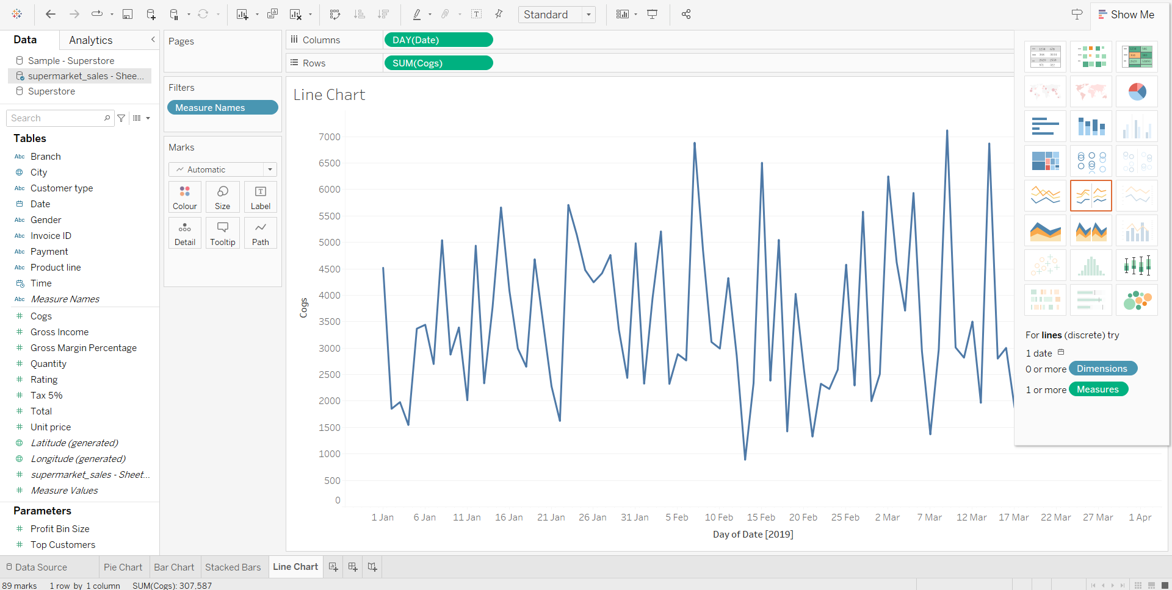
Line Chart:-

Slide 9
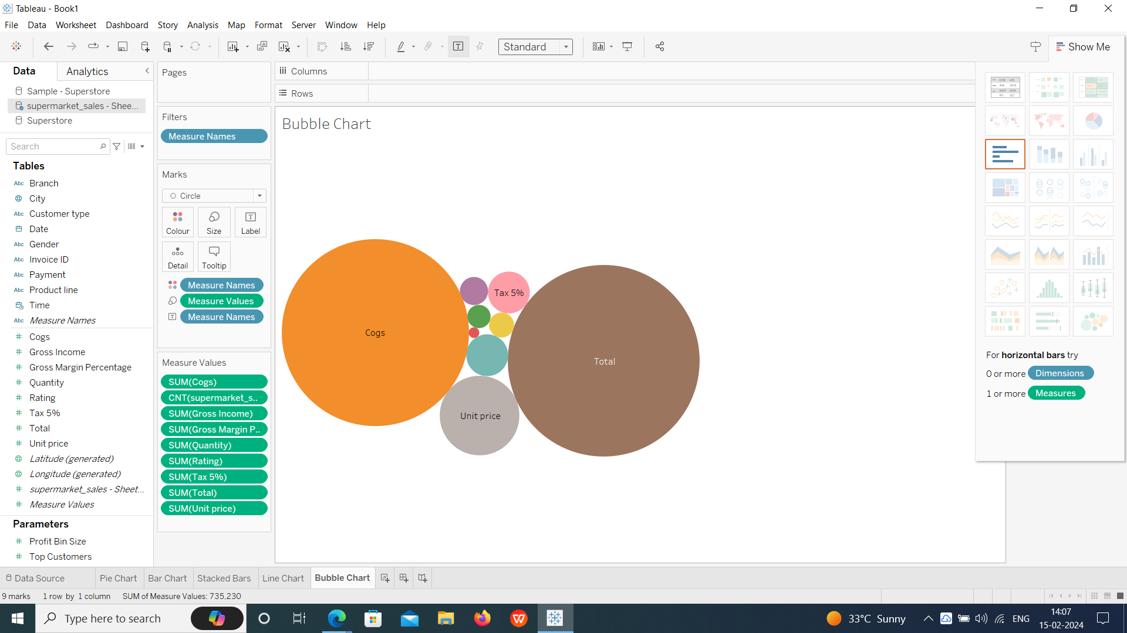
Bubble Chart:-

Slide 10
Thank you
Email:- ramyaraokatta@gmail.com

